Slide 1

The Da Vinci Code of Conduct
Solving the mystery of matters that come before the TTIPAB
Ms. Veg Tran
IPTA Conference
April 2023

Slide 2

The Great Mystery – Disciplinary matters

Slide 3
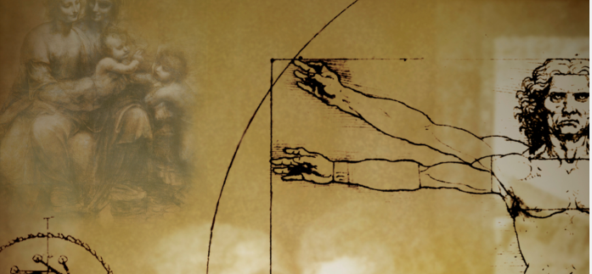
Feedback from the Code of Conduct ‘Health check’
“So, how do we sift truth from belief?
…Today this will be our quest”
You told us that:
There is scope to improve understanding of the Code by enhancing the Guidelines
You would like more detailed information about the types of complaints received and the outcomes – what learnings can be communicated from the Board
The Board should facilitate the provision of additional CPE on the Code

Slide 4
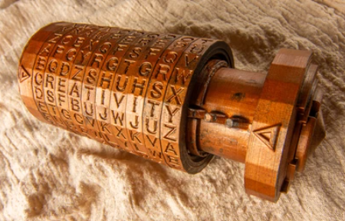
Overview of the complaint resolution procedure
“A cryptex! – they are used to keep secrets…”
Complaint received
Secretariat corresponds with both parties
Material considered by the Board and decision made
If the matter is not referred to the Tribunal, both parties are informed
If the matter is referred, the Disciplinary Tribunal process takes over
The matter is heard by the Disciplinary Tribunal and a written decision published

Slide 5
How many complaints have been formally lodged with the Board since the Trans-Tasman regime came into operation?

Slide 6
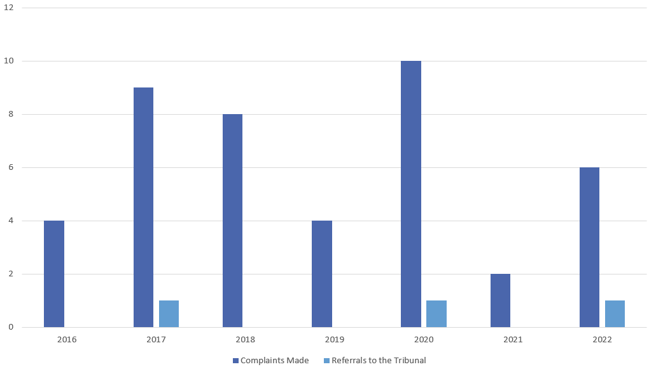
Complaints made under the Trans-Tasman Regime
“Understanding our past determines actively our ability to understand the present.”

Slide 7
Have more complaints been made about patent attorneys or trade mark attorneys?

Slide 8

What are the types of complaints?
“Seek the truth, seek The Code”

Slide 9
Which area(s) of the Code have the complaints been about?

Slide 10
Areas of the Code cited in complaints

Slide 11
Examples of types of complaints
Complaint type | Example
Competency | The provision of advice outside of an attorney’s core practice or outside of their field of technical training.
Integrity | Dealing with clients in a discourteous manner, such as bullying them into limiting the scope of their IP.
Diligence | The provision of advice in an untimely manner leading to unnecessary expense and/or adversely affecting the IP rights of the client.

Slide 12
Examples of types of complaints
Complaint type | Example
Conflict of interest | Having one firm act for both applicant and opponent in an opposition matter – even when different individual attorneys are involved.
Privacy | The recording of client meetings without their knowledge and agreement.
Communication | Failure to advise the client of expected timing and estimated costs for completion of the work.
Responsibility | Failure to take responsibility for the work of an ‘associated person’ who has been contracted to perform searches and/or complete drafting tasks.

Slide 13

Early Intervention Strategies
“But first, a test of honor”
What can you do to mitigate a complaint being filed?
Read and understand the Code and the Guidelines
Talk to your client in the first instance
Consider whether the Board or the Disciplinary Tribunal has the power to order the remedies sought

Slide 14
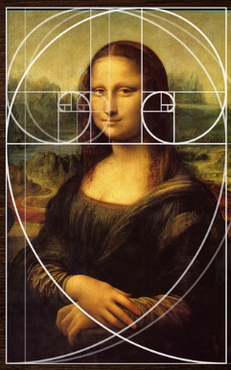
Recent action by Board and the future work plan
“What is history, but a fable agreed upon ?”
Guidelines to the Code are being updated now
Improved communication from the Board and the Secretariat
New complaint form is being developed
Clarification of the role of the Secretary

Slide 15


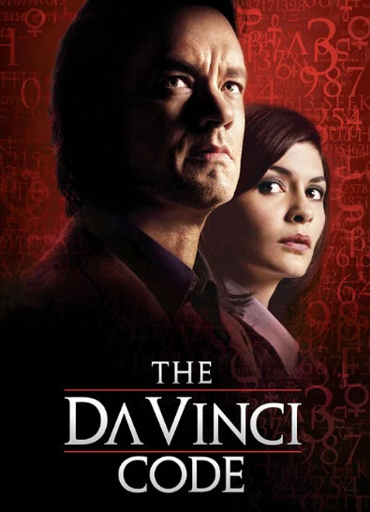
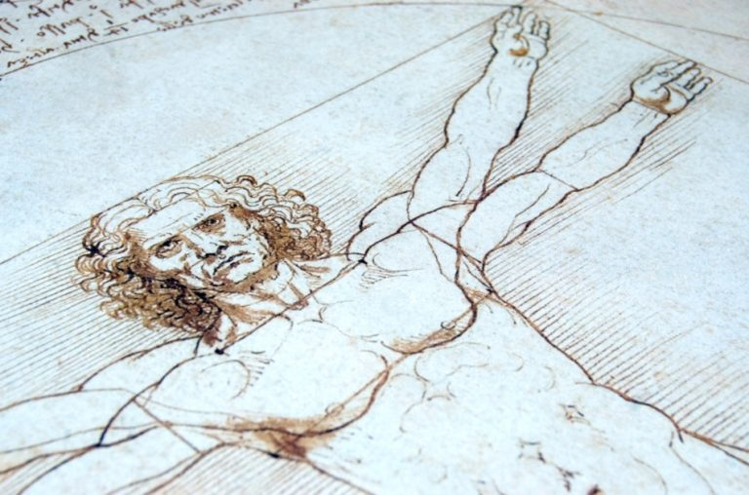
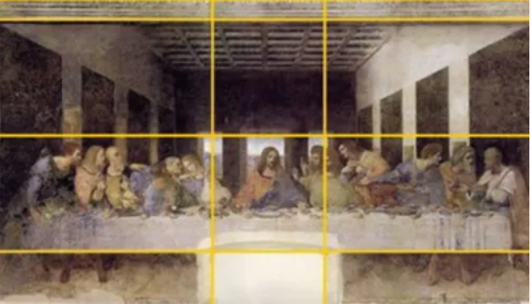
Questions?
All quotes are from The Da Vinci Code (2006) directed by Ron Howard and starring Tom Hanks and Audrey Tatou. All images are either free to use or used under an existing content license.

